Slide 1
Game AI/Game Engines 2 Finite State Machines
Dr Bryan Duggan
Dublin Institute of Technology

Slide 2
What we will learn
What is a finite state machine?
Why they are useful?
Various approaches to implement them
The Finite State Machine Design Pattern (the best way)
Enhancements:
Global states
Messaging

Slide 3
Now we can…
Move things around autonomously
Avoid obstacles
Program emergent behaviour
But we have no way to have our game entities make decisions...
I'm being attacked I better evade
My health is low is better pick up some
I can see the player attack!

Slide 4

State/State Machines
Alan Turing's hypothetical device: the Turing machine,
1936 paper, "On Computable Numbers."
A machine that could perform any mathematical operation by operation by reading, writing, and erasing symbols on an infinitely long strip of tape.
A finite state machine is a device, or a model of a device, which has a finite number of states it can be in at any given time and can operate on input to either make transitions from one state to another or to cause an output or action to take place. A finite state machine can only be in one state at any moment in time.
Matt Buckland

Slide 5

State
An agent can be in only one state at a time (or maybe two with global states)
State means behaviour
Some input causes the FSM to switch state
E.g.:
Switch down
ON
OFF
Switch up

Slide 6
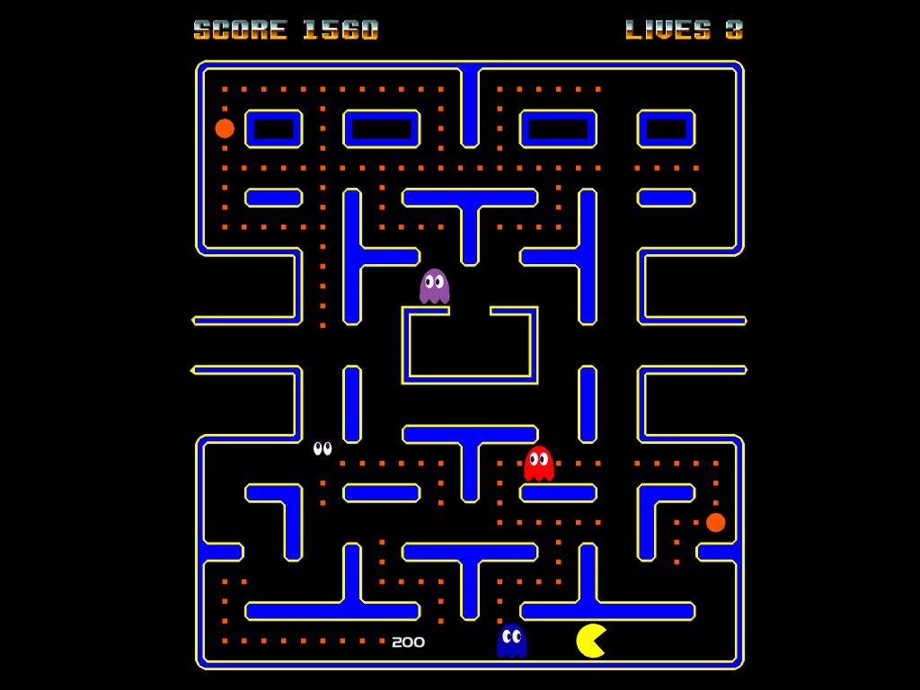
Example Pac man ghosts

Slide 7
States
Chase
Evade

Slide 8
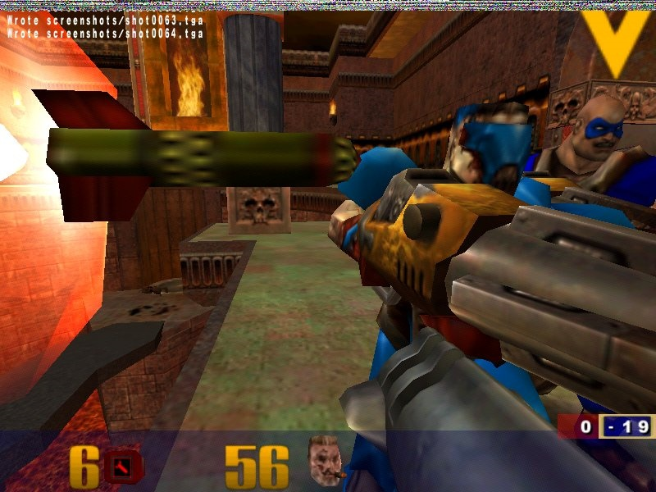
Quake Bots

Slide 9
States
FindArmour
FindHealth
SeekCover
RunAway

Slide 10
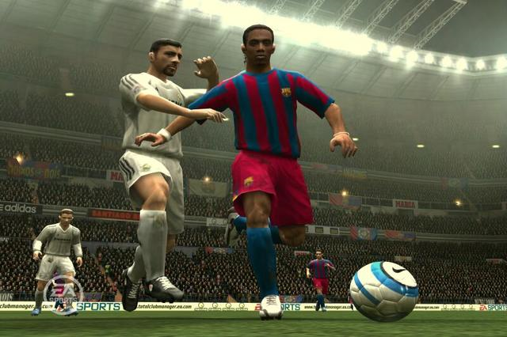
Sports Simulations

Slide 11
States
KickOff
Defend
WalkOnField

Slide 12
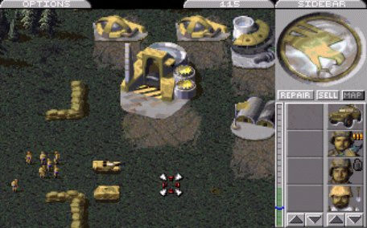
RTS

Slide 13
States
MoveToPosition
Patrol
FollowPath

Slide 14
Advantages
They are quick and simple to code.
See examples in BGE
They are easy to debug
Behaviour is broken down into easily manageable chunks
You can easily log transitions
They have little computational overhead.
Use hardly any precious processor time because they essentially IF statements
There is no real "thinking" involved
They are intuitive
Easy to discuss the design of AI with non-programmers
They are flexible.
Easy to add new states

Slide 15
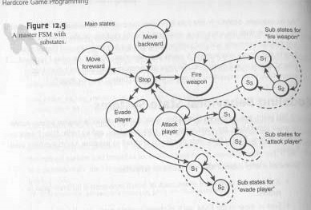
State Transition Diagrams

Slide 16
State Transition Diagram for DalekWorld (A “game” I wrote several years ago)

Slide 17
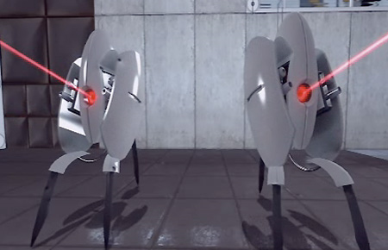
Portal Turret

Slide 18
Sleep
Mode
Sees the player
Attacking
Picked
Up
Time elapsed
Player moves out of range
Dropped by the player
Shutting
Down
Searching
Dead

Slide 19
Implementing a FSM
Use a switch statement?
switch (state)
{
case RunAway:
if (safe())
{
ChangeState(Patrol);
}
break;
case Patrol:
if (danger())
{
ChangeState(Attack);
}
break;
…
…
}

Slide 20
Problems with this approach
Unwieldy
Spaghetti
Program flow difficult to code
No way to have special behaviour when you enter a state and exit a state

Slide 21
Alternative
A state class
Knows which GameObject it’s attached to
The rules for transitions go into the Update method
You can put special behaviours for transitions into Enter and Exit
public abstract class State
{
protected GameObject entity;
public State(GameObject entity)
{
this.entity = entity;
}
public abstract string Description();
public GameObject Entity
{
get { return entity; }
set { entity = value; }
}
public abstract void Enter();
public abstract void Exit();
public abstract void Update();
}

Slide 22
The StateMachine class
In Unity3D it’s a GameComponent
Keeps track of the current state
Update calls Update on current state
SwitchState calls Exit on the current state and Enter on the new state
public class StateMachine:MonoBehaviour
{
State currentState;
void Start()
{
}
public void Update()
{
if (currentState != null)
{
SteeringManager.PrintMessage("Current state: " + currentState.Description());
currentState.Update();
}
}
public void SwicthState(State newState)
{
if (currentState != null)
{
currentState.Exit();
}
currentState = newState;
if (newState != null)
{
currentState.Enter();
}
}
}
}

Slide 23
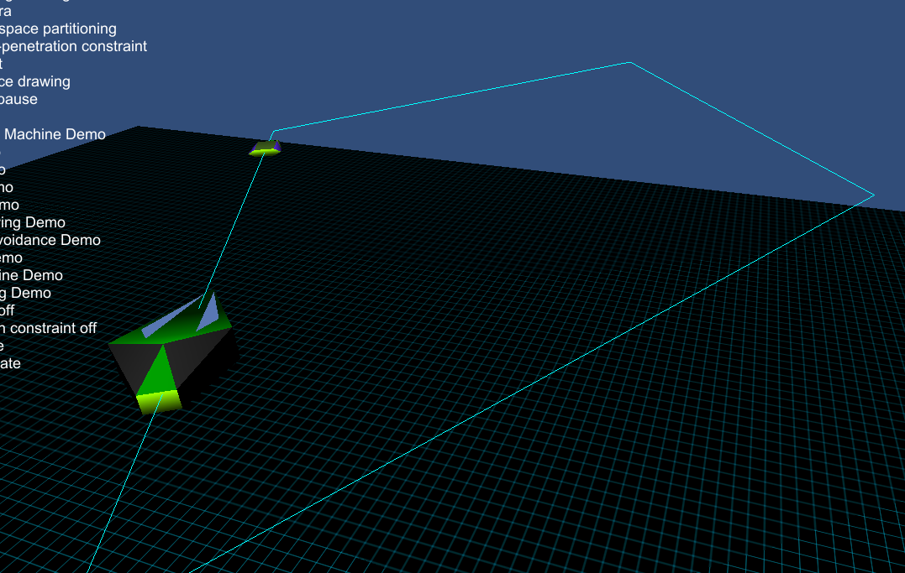
Example
The first boid is in it’s idle state, following a path
The second boid is in its tease state and pursuing the first boid

Slide 24
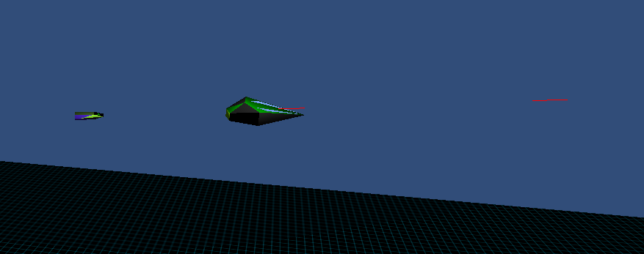
Example
The first boid switches to Attacking when the first boid comes in range
The second boid switches to evade. It’s faster, so it will escape

Slide 25
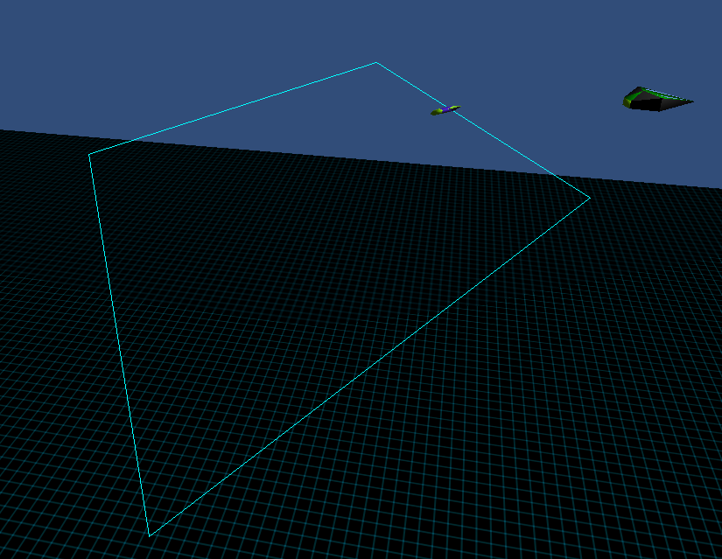
Example
The first boid will go back to idle state if the second boid goes out of range
The second boid will similarly go back to tease

Slide 26
public class IdleState:State
{
public override void Enter()
{
entity.GetComponent<SteeringBehaviours>().path.Waypoints.Add(initialPos);
entity.GetComponent<SteeringBehaviours>().path.Waypoints.Add(initialPos + new Vector3(-50, 0, 80));
entity.GetComponent<SteeringBehaviours>().path.Waypoints.Add(initialPos + new Vector3(0, 0, 160));
entity.GetComponent<SteeringBehaviours>().path.Waypoints.Add(initialPos + new Vector3(50, 0, 80));
entity.GetComponent<SteeringBehaviours>().path.Looped = true;
entity.GetComponent<SteeringBehaviours>().path.draw = true;
entity.GetComponent<SteeringBehaviours>().TurnOffAll();
entity.GetComponent<SteeringBehaviours>().FollowPathEnabled = true;
entity.GetComponent<SteeringBehaviours>().ObstacleAvoidanceEnabled = true;
}
public override void Exit()
{
entity.GetComponent<SteeringBehaviours>().path.Waypoints.Clear();
}
public override void Update()
{
float range = 50.0f;
// Can I see the leader?
GameObject leader = SteeringManager.Instance.currentScenario.leader;
if ((leader.transform.position - entity.transform.position).magnitude < range)
{
// Is the leader inside my FOV
entity.GetComponent<StateMachine>().SwicthState(new AttackingState(entity));
}
}
}

Slide 27
class AttackingState:State
{
public override void Enter()
{
entity.GetComponent<SteeringBehaviours>().TurnOffAll();
entity.GetComponent<SteeringBehaviours>().OffsetPursuitEnabled = true;
entity.GetComponent<SteeringBehaviours>().offset = new Vector3(0, 0, 5);
entity.GetComponent<SteeringBehaviours>().leader = SteeringManager.Instance.currentScenario.leader;
}
public override void Update()
{
float range = 50.0f;
timeShot += Time.deltaTime;
float fov = Mathf.PI / 4.0f;
// Can I see the leader?
GameObject leader = SteeringManager.Instance.currentScenario.leader;
if ((leader.transform.position - entity.transform.position).magnitude > range)
{
entity.GetComponent<StateMachine>().SwicthState(new IdleState(entity));
}
else
{
float angle;
Vector3 toEnemy = (leader.transform.position - entity.transform.position);
toEnemy.Normalize();
angle = (float) Math.Acos(Vector3.Dot(toEnemy, entity.transform.forward));
if (angle < fov)
{
if (timeShot > 0.25f)
{
GameObject lazer = new GameObject();
lazer.AddComponent<Lazer>();
lazer.transform.position = entity.transform.position;
lazer.transform.forward = entity.transform.forward;
timeShot = 0.0f;
}
}
}
}

Slide 28
public class TeaseState:State
{
GameObject teasee;
public override string Description()
{
return "Tease State";
}
public TeaseState(GameObject entity, GameObject teasee):base(entity)
{
this.teasee = teasee;
}
public override void Enter()
{
entity.GetComponent<SteeringBehaviours>().TurnOffAll();
entity.GetComponent<SteeringBehaviours>().PursuitEnabled = true;
//entity.GetComponent<SteeringBehaviours>().WanderEnabled = true;
entity.GetComponent<SteeringBehaviours>().target = teasee;
}
public override void Update()
{
if (Vector3.Distance(entity.transform.position, teasee.transform.position) < 20)
{
entity.GetComponent<StateMachine>().SwicthState(new EvadeState(entity, teasee));
}
}

Slide 29
class EvadeState:State
{
GameObject teasee;
public override string Description()
{
return "Evade State";
}
public EvadeState(GameObject entity, GameObject teasee):base(entity)
{
this.teasee = teasee;
}
public override void Enter()
{
entity.GetComponent<SteeringBehaviours>().TurnOffAll();
entity.GetComponent<SteeringBehaviours>().EvadeEnabled = true;
entity.GetComponent<SteeringBehaviours>().WanderEnabled = true;
entity.GetComponent<SteeringBehaviours>().target = teasee;
}
public override void Update()
{
if (Vector3.Distance(entity.transform.position, teasee.transform.position) > 200)
{
entity.GetComponent<StateMachine>().SwicthState(new TeaseState(entity, teasee));
}
}

Slide 30
Should states be singletons?
Yes?
States are shared across agents
Less memory fragmentation
No?
Personally I prefer no!
States can store state
Example: Teaser needs to know who the tease is

Slide 31
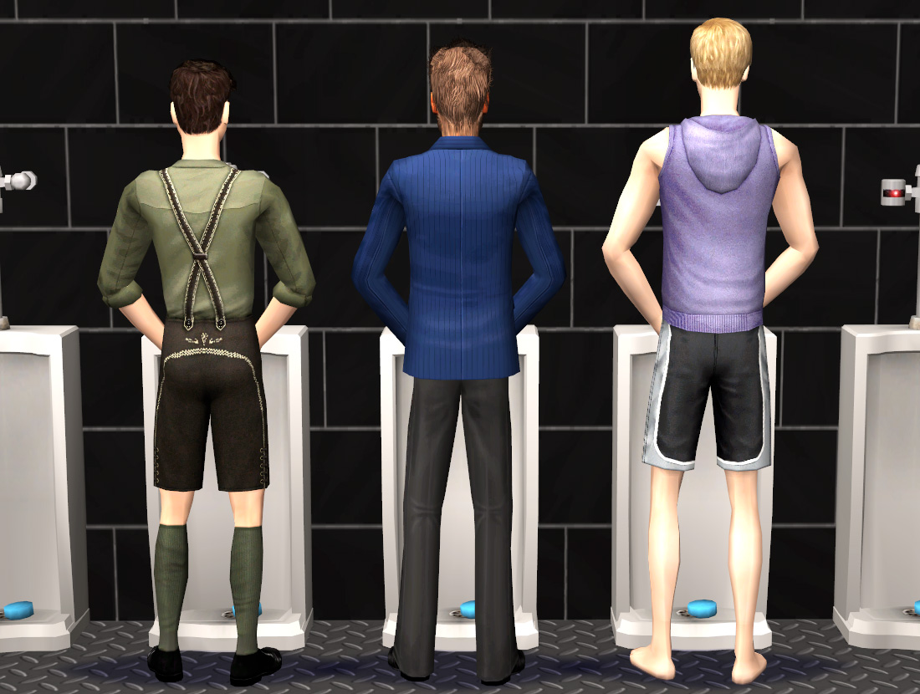
Global states
Sometimes when designing FSM’s code gets duplicated in every state
Example: in The Sims, a Sim may need to pee from any state
It should pee and then return to its previous state

Slide 32
How to implement?
Add two extra fields to the state machine:
Previous state
Global state
In Update
Update the current state
But also update the global state
Add a method:
RevertToPreviousState

